Slide 1
Guided Capstone Slide Deck
Big Mountain Resort

Slide 2
Problem Identification
Implement a data-driven business strategy for ticket pricing, reducing overhead, and efficient distribution of capital amongst the facilities in order to increase profitability.
Strategies must reduce operating costs without a reduction in supported ticket price, and/or lead to increased support for an even higher ticket price. They must also be able to be implemented this season to offset the increased operating costs associated with the newly installed chairlift.
Will focus on numerous factors including competitor’s pricing, features, and facilities offered.

Slide 3
Recommendations and Key Findings
Increase Ticket Prices for Adult Weekend Tickets
Our predictive model suggests a ticket price of $95.87 based on current prices set by competitors in our dataset.
Close Down 1 of the 10 Least Used Runs
This will help reduce operating costs. Our analysis indicated doing so has no negative impact on support for ticket prices or revenue.
Increase Vertical Drop by Adding Additional Run, Chairlift
Leads to increased support for higher ticket prices and subsequently increases revenue.

Slide 4
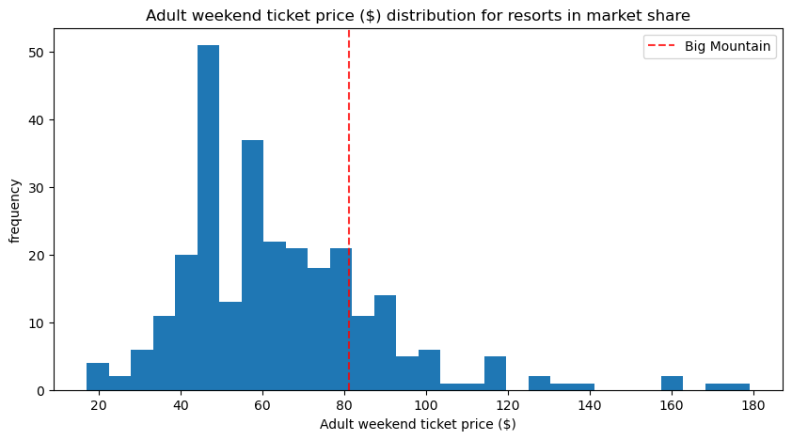
Modeling Results and Analysis
At current price of $81.00, Big Mountain sits on the higher end compared to most other resorts. Our predictive model for ticket prices resulted in a modeled price of $95.87, suggesting that current price point is actually undervalued.

Slide 5
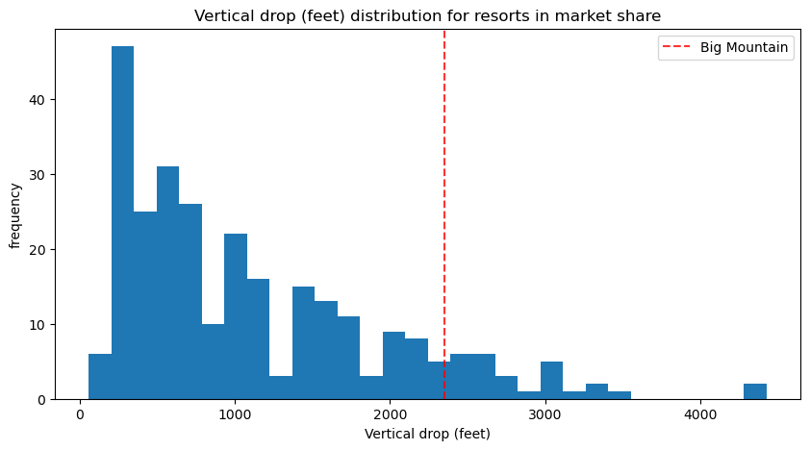
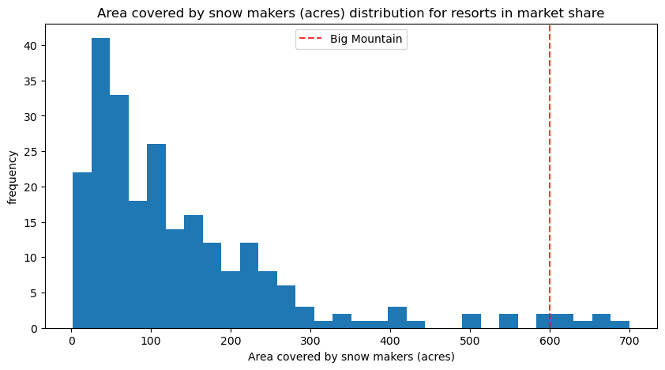
Modeling Results and Analysis (cont.)
Big Mountain is also above average in regards to several features and facilities that consumers are willing to pay a higher price for such as:

Slide 6
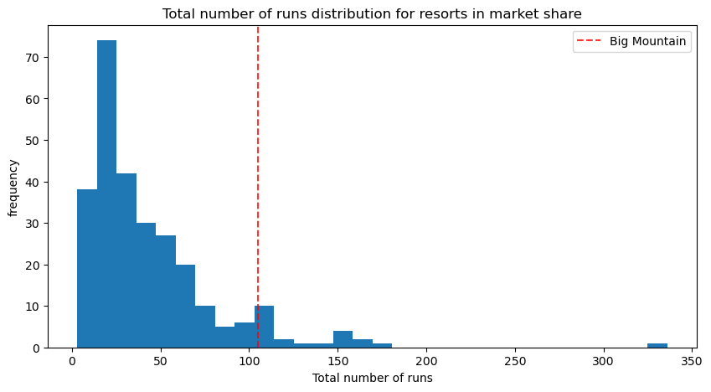
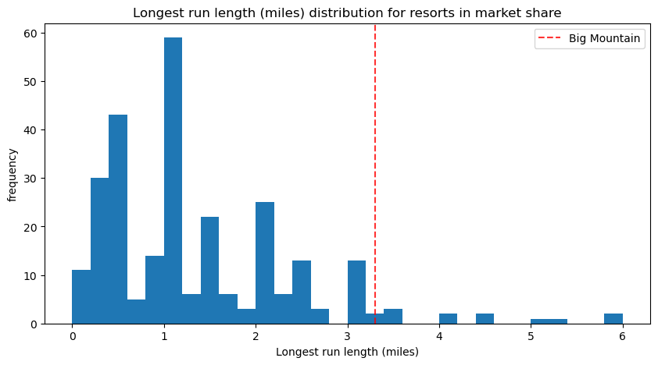
Modeling Results and Analysis (cont.)

Slide 7
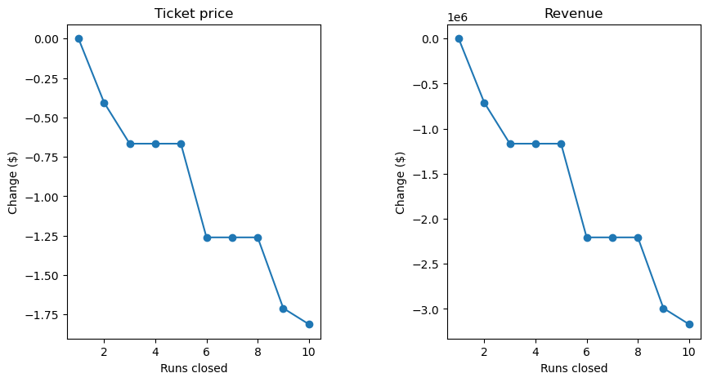
Modeling Results and Analysis (cont.)
Closing down one of the ten least popular runs showed no negative impact on support for ticket prices or revenue. Even after taking into account the cost of an additional lift, the addition of a new run to increase vertical drop showed an increase of $8.61 in support for ticket prices, amounting to $15,065,471 over the course of the season.

Slide 8
Summary and Conclusion
Based on our modeling, Big Mountain Resort has been undercharging for their adult weekend tickets and limiting its earning potential. A resort with facilities of this quality should be charging higher ticket prices, which reinforces the higher modeled price obtained through our predictive model.
Our analysis indicated two additional avenues to cut costs and increase revenue. We found that closing down one of the ten least popular runs had no effect on support for ticket prices or overall revenue. While adding an additional run to increase vertical drop by 150 feet, and installing an additional chairlift led to increased support for ticket prices by $8.61 which over the course of the season would amount to $15,065,471 in additional revenue.
By making these changes, Big Mountain Resort has the opportunity to both reduce some of their operating costs as well as raise their ticket prices leading to increased profitability.

